Slide 1

HOUSE PRICE PREDICTION by KUNIGIRI NAGARAJU

Slide 2
Overview
In this particular presentation we will be looking on:
How to analyze the House price prediction dataset
Data Cleaning
Exploratory Data Analysis
Overall analysis on the problem
Model building for prediction of price
Prediction of house price using test dataset

Slide 3
Problem Statement
Houses are one of the necessary needs of every person around the globe and therefore housing and real estate market is one of the markets which is one of the major contributors in the world’s economy. It is a very large market, and various companies are working in the domain. Data science is a very important tool to solve problems in the domain to help copies increase their overall revenue and profits, improve their marketing strategies, and focus on changing trends in house sales and purchases. Predictive modeling, Market mix modeling, and recommendation systems are some of the machine learning techniques used for achieving the business goals of housing companies. Our problem is related to one such housing company.

Slide 4
Problem Understanding
A US-based housing company named Surprise Housing has decided to enter the Australian market. The company uses data analytics to purchase houses at a price below their actual values and flip them at a higher price. For the same purpose, the company has collected a data set from the sale of houses in Australia. The data provided in the CSV file is given
The company is looking at prospective properties to buy houses to enter the market. You are required to build a model using Machine Learning to predict the actual value of the prospective properties and decide whether to invest in them or not. This company wants to know:
• Which variables are important to predict the price of a variable?
• How do these variables describe the price of the house?

Slide 5
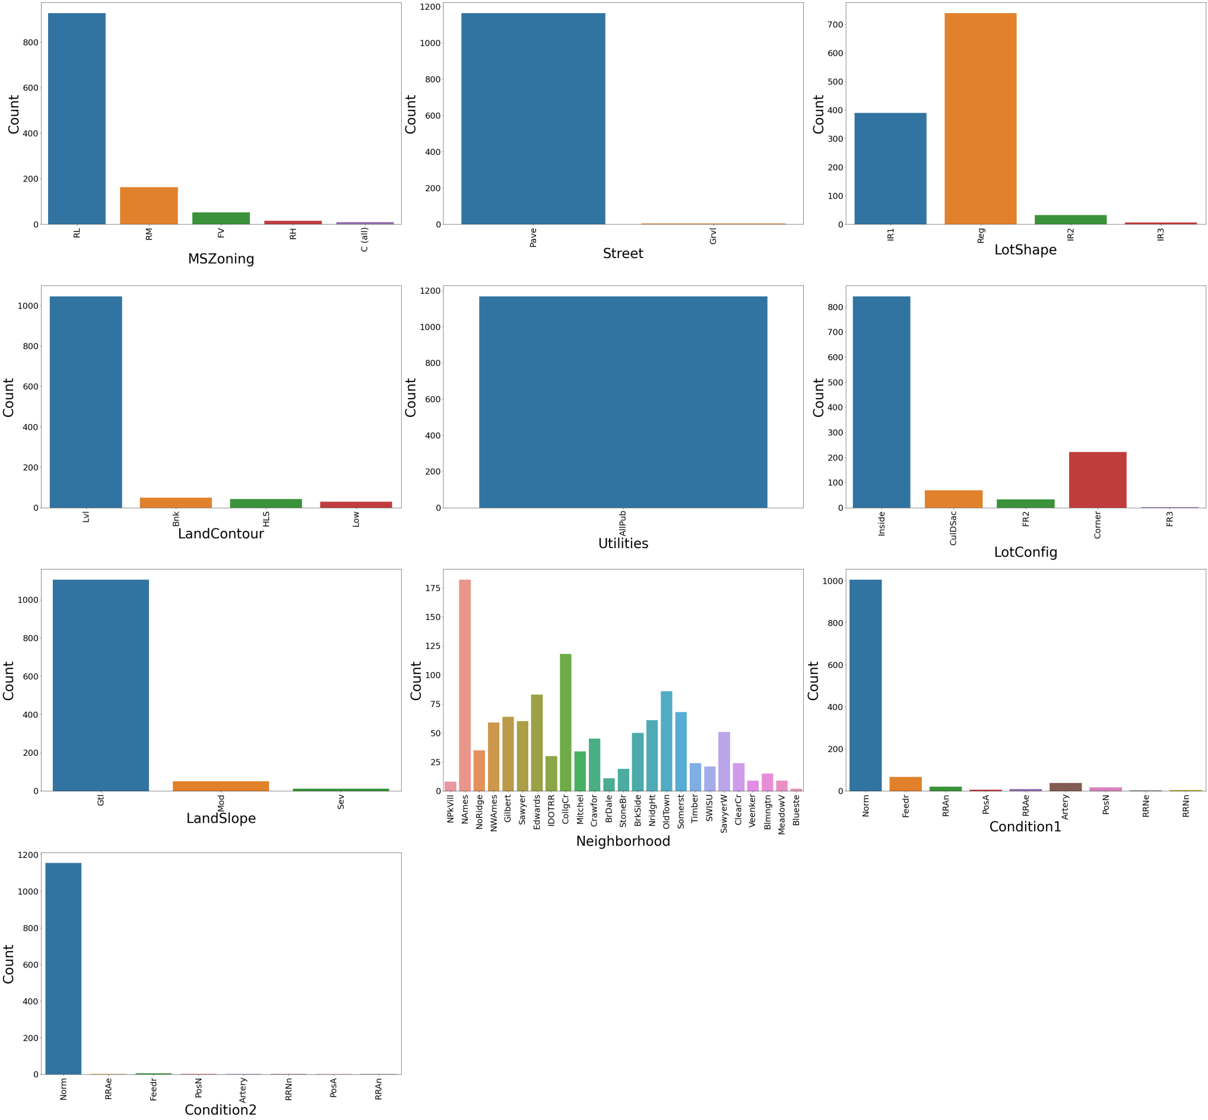
EXPLORATORY DATA ANALYSIS

Slide 6
EXPLORATORY DATA ANALYSIS
Residential with the low-density zone is much more in counts comparatively to others
Most of the property is with paved streets very few are Gravel
Regular-shaped property is preferable compared to others. Slightly irregular comes next.
89.6% of the property is flat or near flat. 4.3 % at the bank, 3.6 % at the hillside, and the remaining are on the depression side
All the utilities are public (Electricity, Gas, Water, Septic Tank, etc )
Among all available houses 72.1 % are an inside lot, 19% are at the corner,5.9 % are Cul-de-sacs, 2.8 %
Frontage on 2 sides of the property and very few are Fontage on 3 sides of the property
94.6 % slope of the houses is Gentle slop, 4.4 % is moderate and 1 % is Severe slope
There is a higher number of houses in North Ames followed by College Creek, OldTown, Edwards, etc. On the contrary, Blue has got less count as location followed by NpkVill and Veenker
Considering the proximity of conditions 1 & 2 normal conditions are much higher in count compared to others such as
Adjacent to the arterial street, Adjacent to feeder street, Within 200’ of North-South Railroad, Adjacent to North-South Railroad, Near positive off-site feature—park, greenbelt, Adjacent to positive off-site feature, Within 200’ of East-West Railroad, Adjacent to East-West Railroad

Slide 7
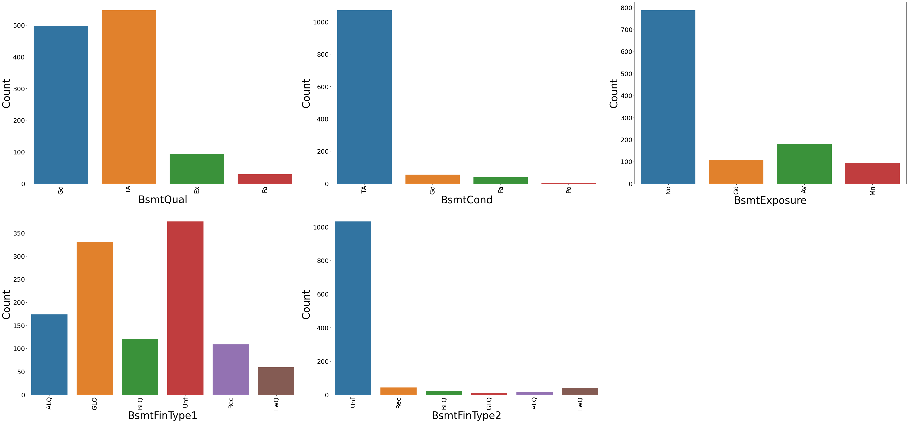
EXPLORATORY DATA ANALYSIS

Slide 8
EXPLORATORY DATA ANALYSIS
- Typical (80-89 inches)basement height has span of 46.8% and Good Height (90-99 inches) covers 42.6 %. Excellent i.e. Houses with 100+ inches are 8%
- 91% basement general condition in Typical
- basement with no exposure is most preferable
- Result of rating of the basement finished area is
(a) 32% say Unfinished
(b) 28.3 % say Good Living Quarters
(c) 14.9 % say Average Living Quarters
(d) 9.3% average rec romm and 5 % low quality
- In case of rating of basement finished area( if multiple types ) the
The unfinished rating is at maximum

Slide 9
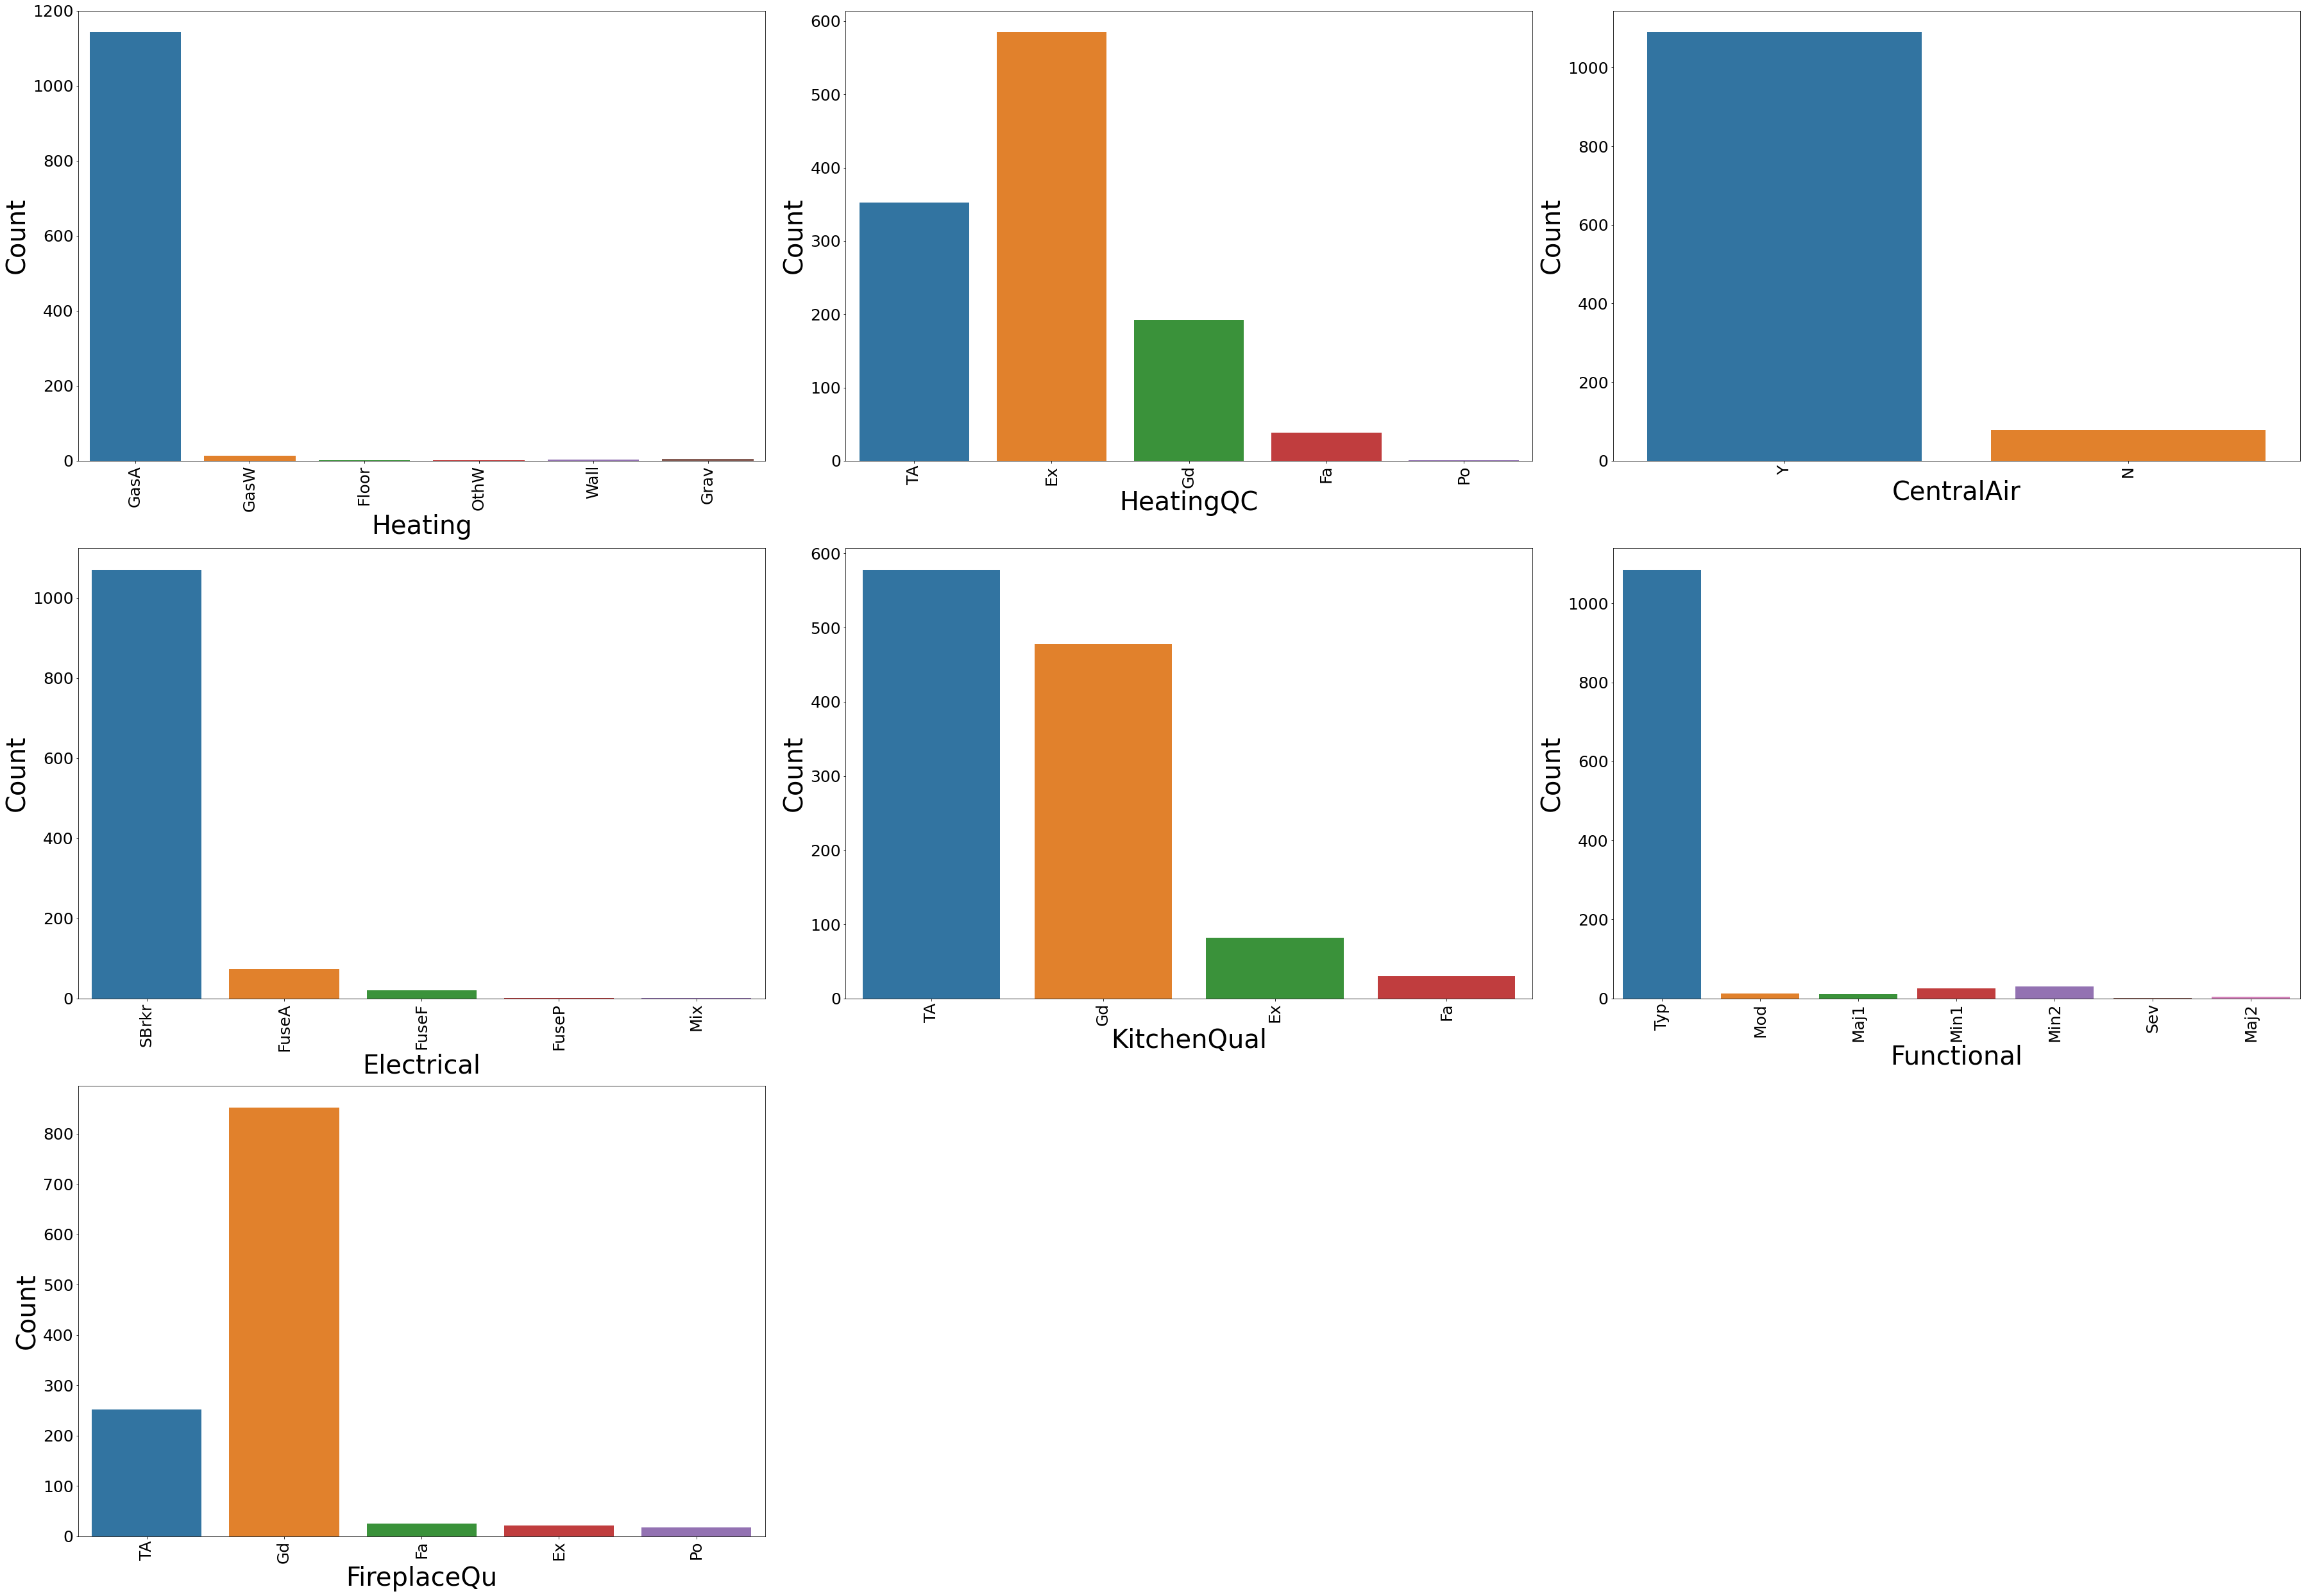
EXPLORATORY DATA ANALYSIS

Slide 10
EXPLORATORY DATA ANALYSIS
- Almost all the houses are heated by Gas forces warm fir furnace
- Heating quality and condition of 50% of houses at excellent and 30% at average
- Maximum of the houses are with central air conditioning
- Most houses are fitted with Standard Circuit Breakers and Romex
- 49.5% of kitchen quality is average and 40.9 % is good, only 7% at excellent condition
- All most all houses are typical if Home functionality is considered
72.9% of fireplace quality is in good condition,21% are on average, rest are very few

Slide 11
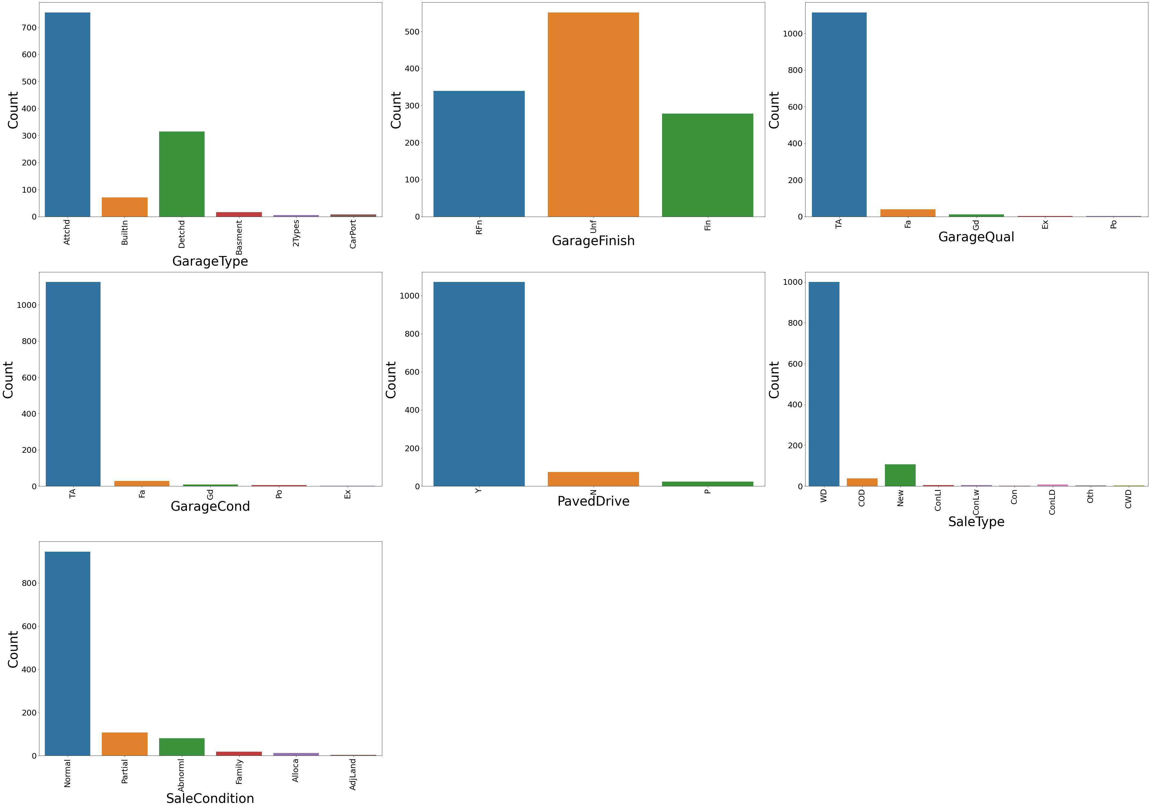
EXPLORATORY DATA ANALYSIS

Slide 12
EXPLORATORY DATA ANALYSIS
- 64.6% are attached garages and 26.9% of houses are with detached garages. Whereas 6% is built-in.
47% of garages are in an unfinished condition,29% are Roughly finished and 23% are finished
- Most of the Garage quality is of average quality
- Also most of the Garage quality is of average quality
47% of garages are in an unfinished condition, 29% are Roughly finished and 23% are finished
- Most of the houses are with paved driveways, and few are Dirt/ Gravel
A maximum type of house sale is Warranty Deed - conventional
- Also the condition of house sale has been normal

Slide 13
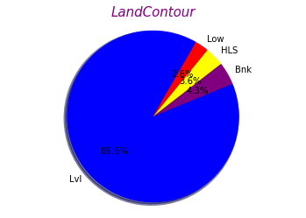
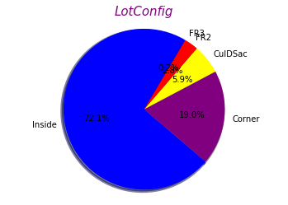
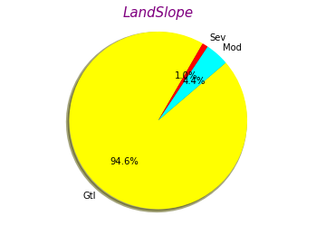
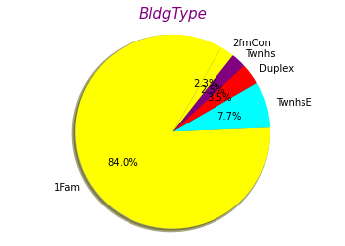
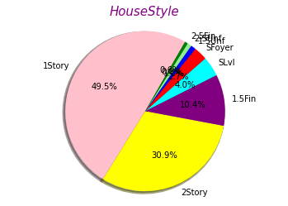
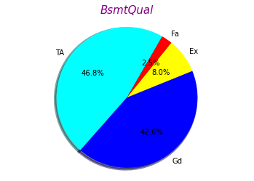
EXPLORATORY DATA ANALYSIS

Slide 14
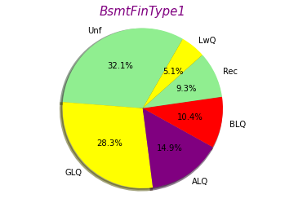
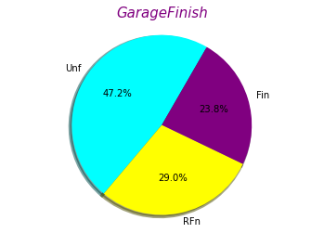
EXPLORATORY DATA ANALYSIS

Slide 15
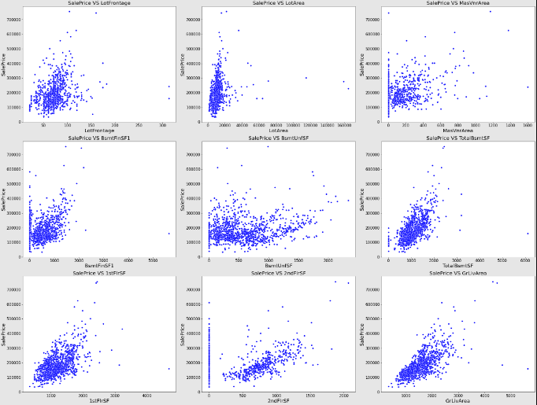
EXPLORATORY DATA ANALYSIS

Slide 16
EXPLORATORY DATA ANALYSIS
- With the increasing level of Linear feet of street connected to the property(LotFrontage) the Sale price decreasing
- As Lot size in square feet(LotArea) has increasing sale price has decreasing
- with increased Masonry veneer area in square feet(MasVnrArea)the sale price has decreased
- Type 1 finished square feet(BsmtFinSF1) is positively correlated with the sales price.
- Sale price has decreased with the increased Unfinished square feet of basement area(BsmtUnfSF)
- Total square feet of basement area(TotalBsmtSF) is positively correlated with sale price
- As First Floor square feet(1stFlrSF) is increased the sale price has increased.
- SalePrice has decreased as the Second floor square feet(2ndFlrSF) has increased.
- Grade (ground) living area square feet(GrLivArea) is positively correlated with the sale price.

Slide 17
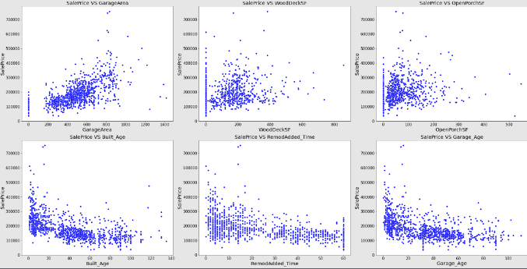
EXPLORATORY DATA ANALYSIS

Slide 18
EXPLORATORY DATA ANALYSIS
- As the size of the garage in square feet(GarageArea) has increased the sale price also has increased.
- There is no significant impact of Wood deck area in square feet(WoodDeckSF) in the sale price.
- There is no significant impact of Open porch area in square feet(OpenPorchSF) in sale price
- Old-built houses have less sale price
- Since Remodel date (same as construction date if no remodeling or additions)(Year_SinceRemodAdded)negatively correlated with sale price
- Garage age is also negatively correlated with the sale price

Slide 19
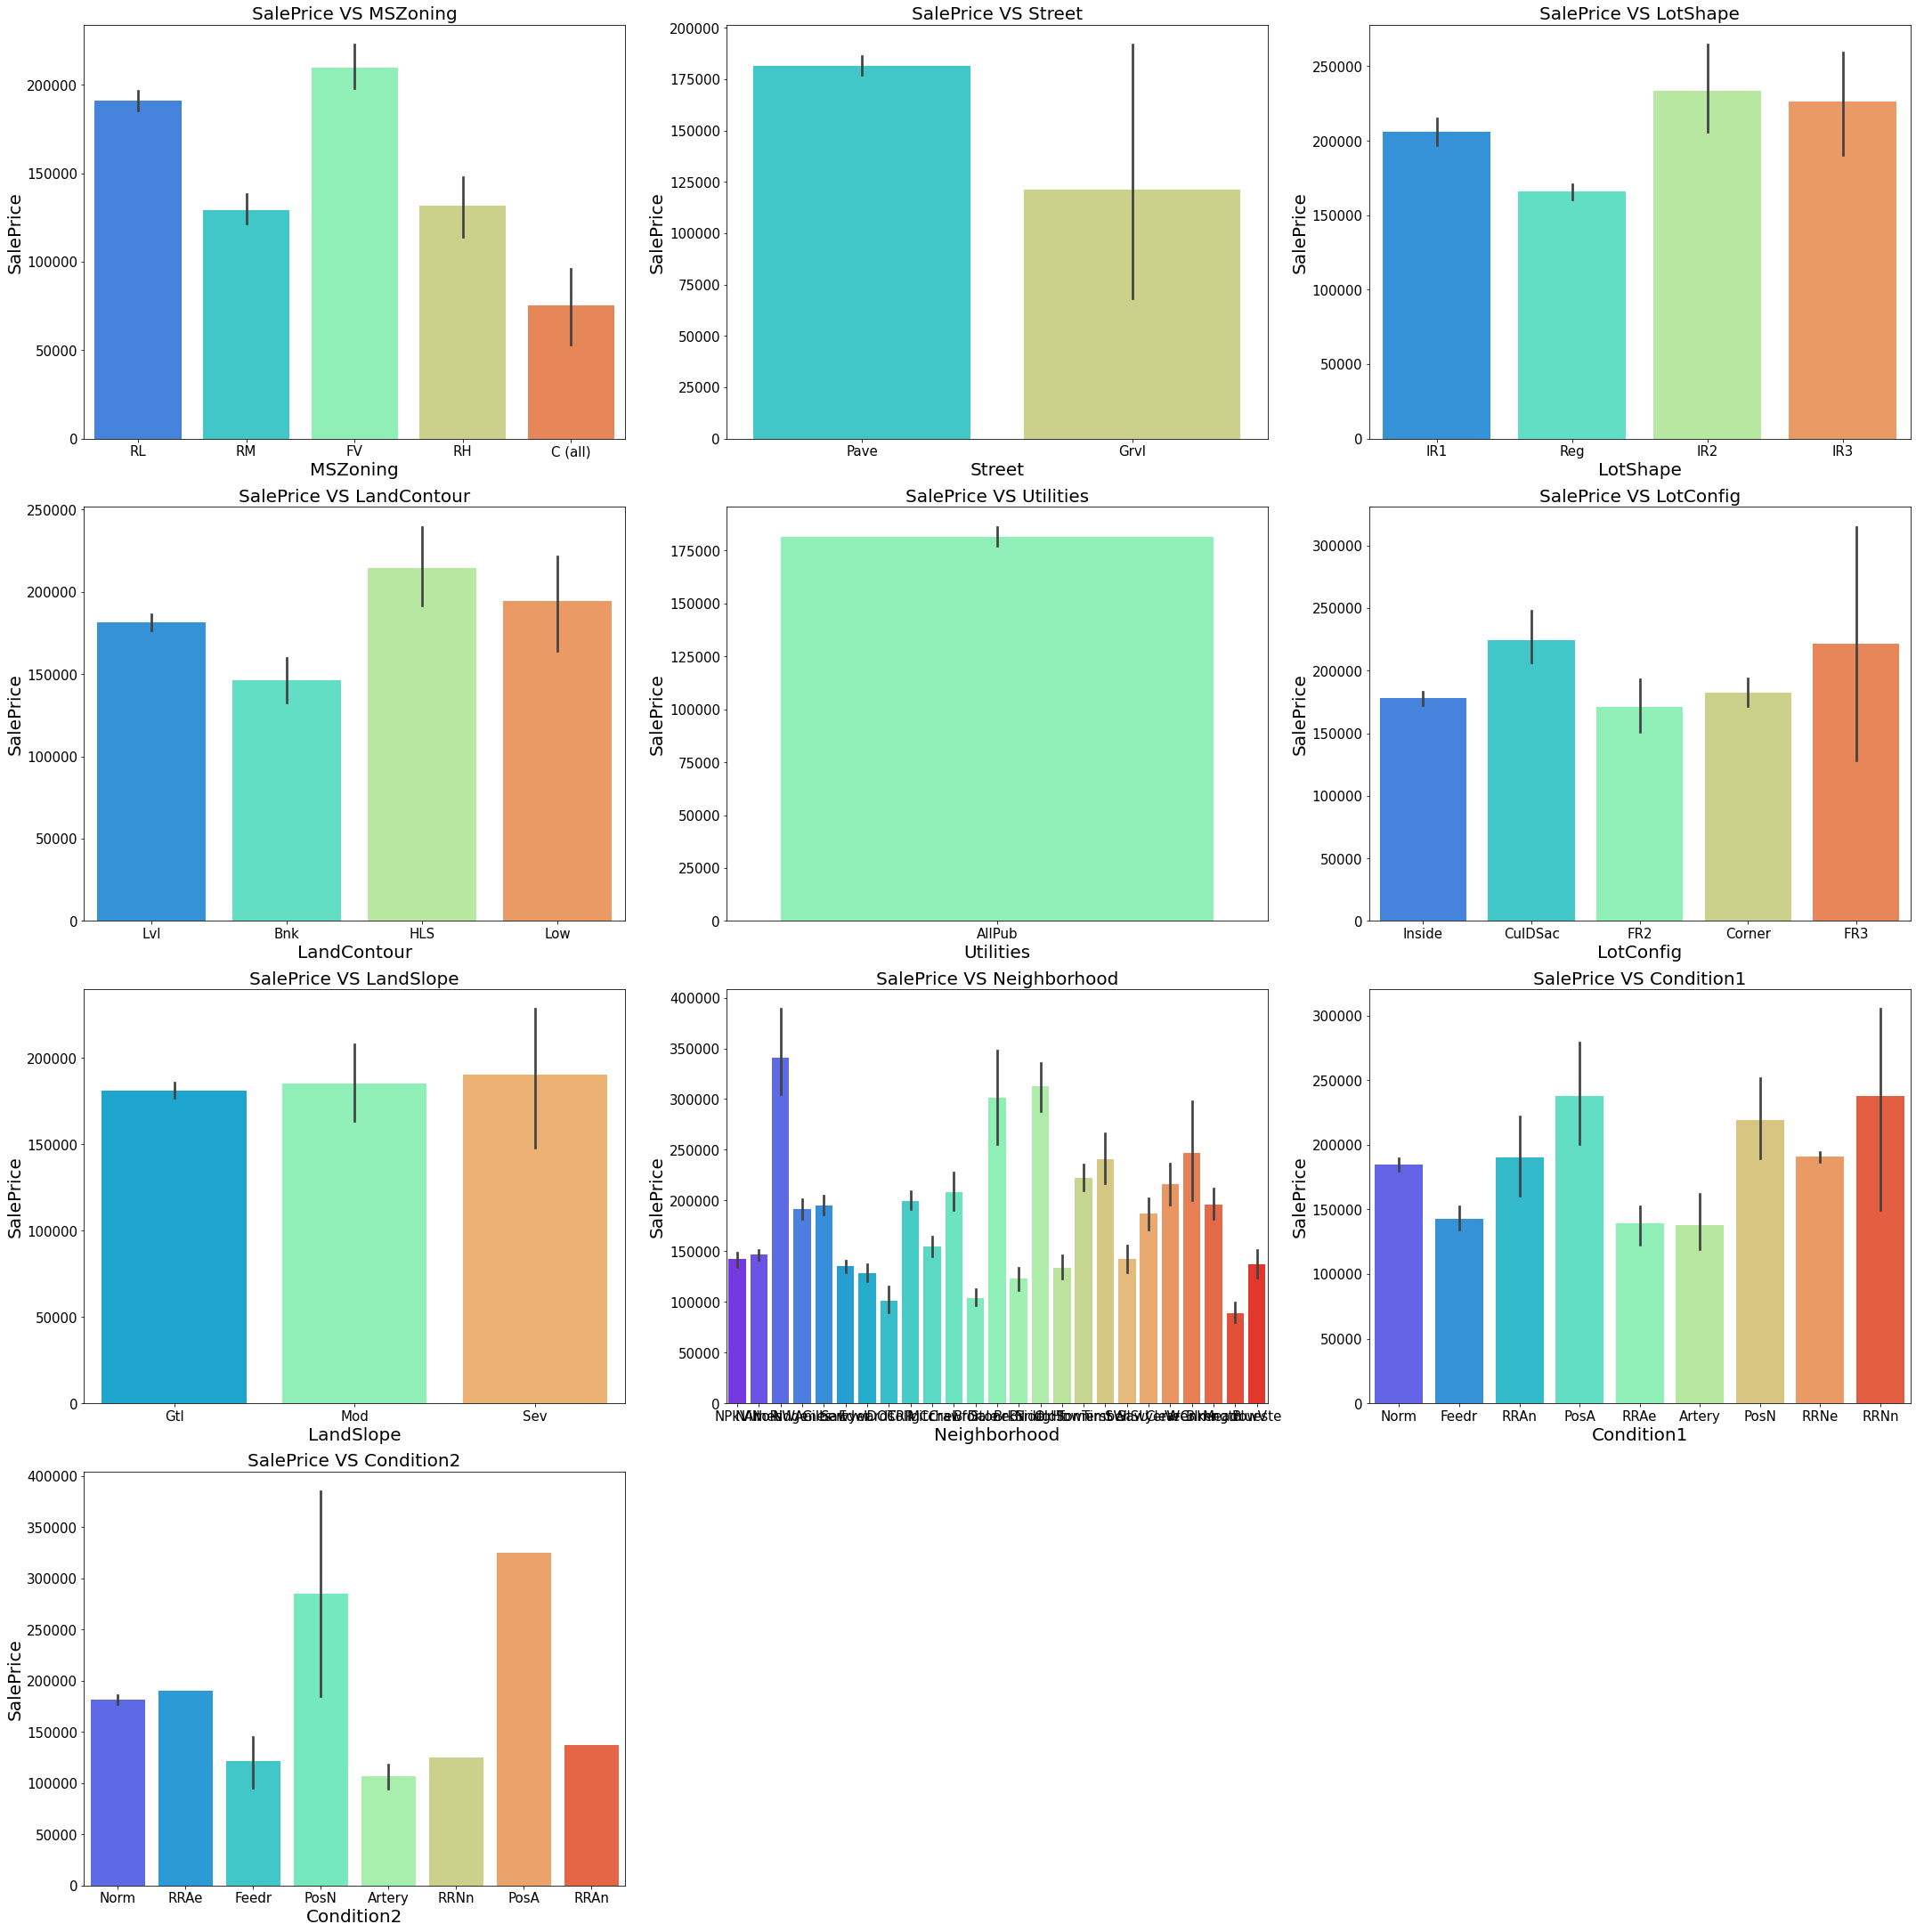
EXPLORATORY DATA ANALYSIS

Slide 20
EXPLORATORY DATA ANALYSIS
The sale price is higher for the following categories
MSZoning – Floating Village Residential(FV) and Residential Low Density(RL)
Street – Paved
LotSpace – Slightly irregular(IR1), Moderately Irregular(IR2), and Irregular(IR3)
LandContour - Slightly higher for Hillside
LotConfig - CulDSac
landscape - all categories all almost the same price
Neighborhood - Northridge(Norridge) locations within Ames city
Condition 1 - Within 200' of North-South Railroad(RRNn), Adjacent to positive off-site feature(Posa) and Near positive off-site feature--park, greenbelt
Condition 2 - Adjacent to positive off-site feature(Posa) and Near positive off-site feature--park, greenbelt

Slide 21
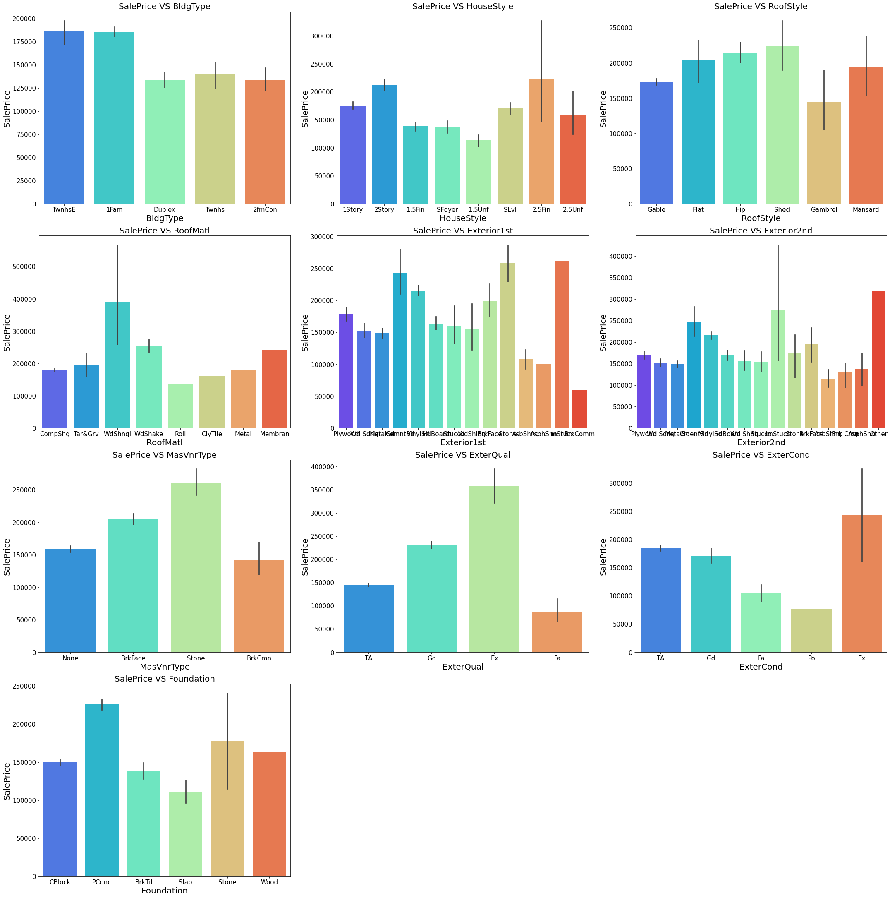
EXPLORATORY DATA ANALYSIS

Slide 22
EXPLORATORY DATA ANALYSIS
Sale price is higher for the following categories
BldgType - Single-family Detached(1Fam) and Townhouse End Unit(TwnhsE)
HouseStyle - 2Story and Two and one-half story
RoofStyle - Shed
RoofMat1 - Wood Shingles
Exterior1st - Cement Board(CemntBd), Imitation Stucco(ImStucc) and Stone type
Exterior2 - Cement Board(CemntBd), Imitation Stucco(ImStucc) and other Exterior covering
MasvnrType - Stone Masonry veneer
ExterQual - Excellent(Ex)
ExterCond - Excellent(Ex)
Foundation - Poured Contrete(PConc)
`

Slide 23
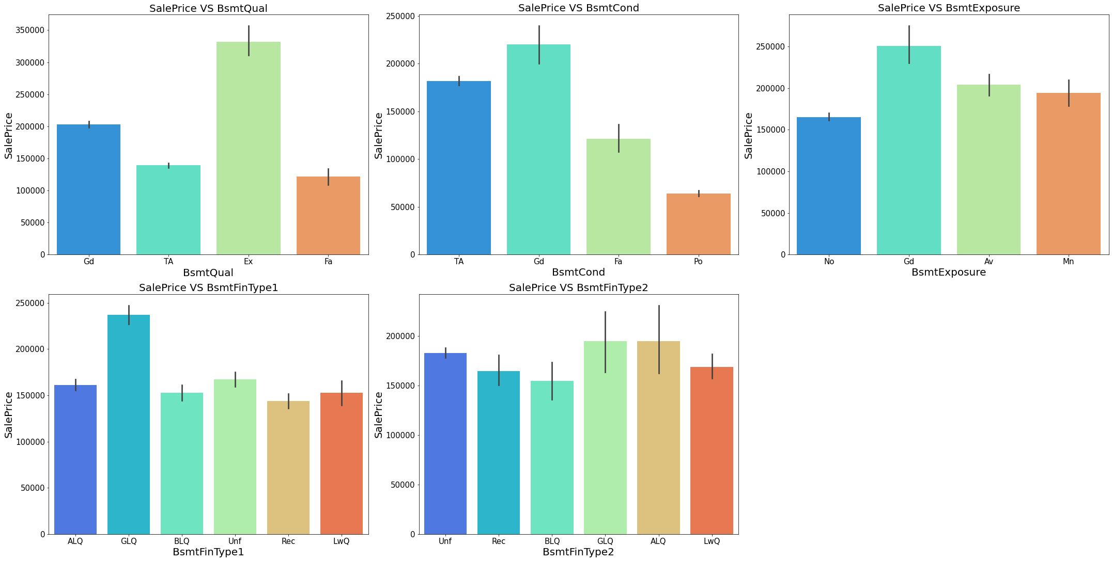
EXPLORATORY DATA ANALYSIS

Slide 24
EXPLORATORY DATA ANALYSIS
Sale price is higher for the following categories
Feature Name: Name of categories for which the sale price is higher
BsmtQual - Excellent(100+ inches)(Ex)
BsmtCond - Good(Gd)
BsmtExposure - Good Exposure(Gd)
BsmtFinType1 - Good Living Quarters(GLQ)
BsmtFinType2 - Good Living Quarters(GLQ) and Average Living Quarters(ALQ)

Slide 25
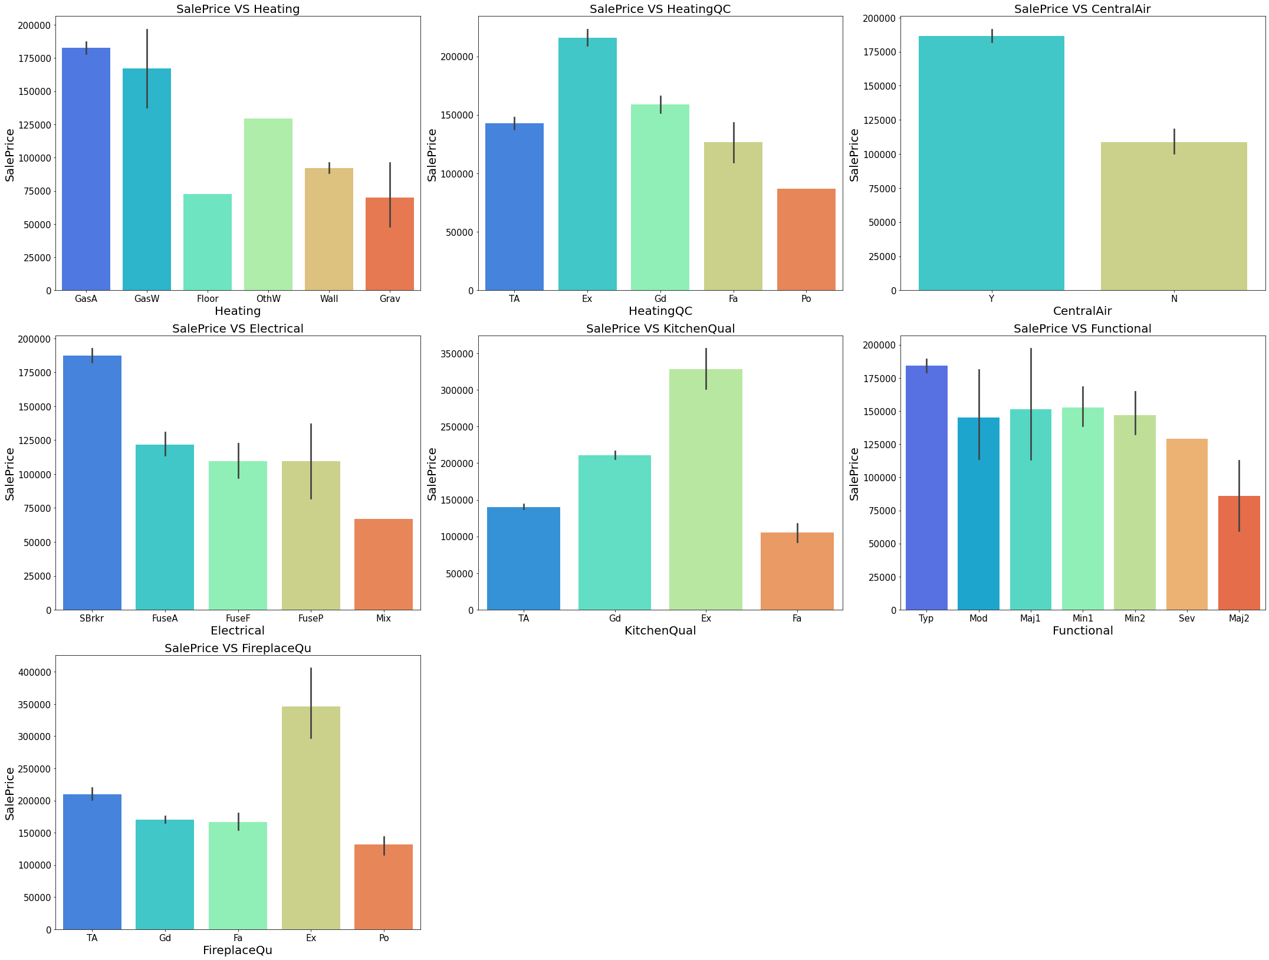
EXPLORATORY DATA ANALYSIS

Slide 26
EXPLORATORY DATA ANALYSIS
The sale price is higher for the following categories
Feature Name: Name of categories for which the sale price is higher
Heating – Gas-forced warm air furnace(GasA) and Gas hot water or steam heat(GasW)
HeatingQC - Excellent(Ex)
CentralAir - Central air conditioning
Electrical - Standard Circuit Breakers & Romex(Sbrkr)
KitchenQual - Excellent(Ex)
Functional - Typical Functionality(Typ) type of Home functionality (Assume typical unless deductions are warranted)
FireplaceQual - Excellent - Exceptional Masonry Fireplace(Ex)

Slide 27
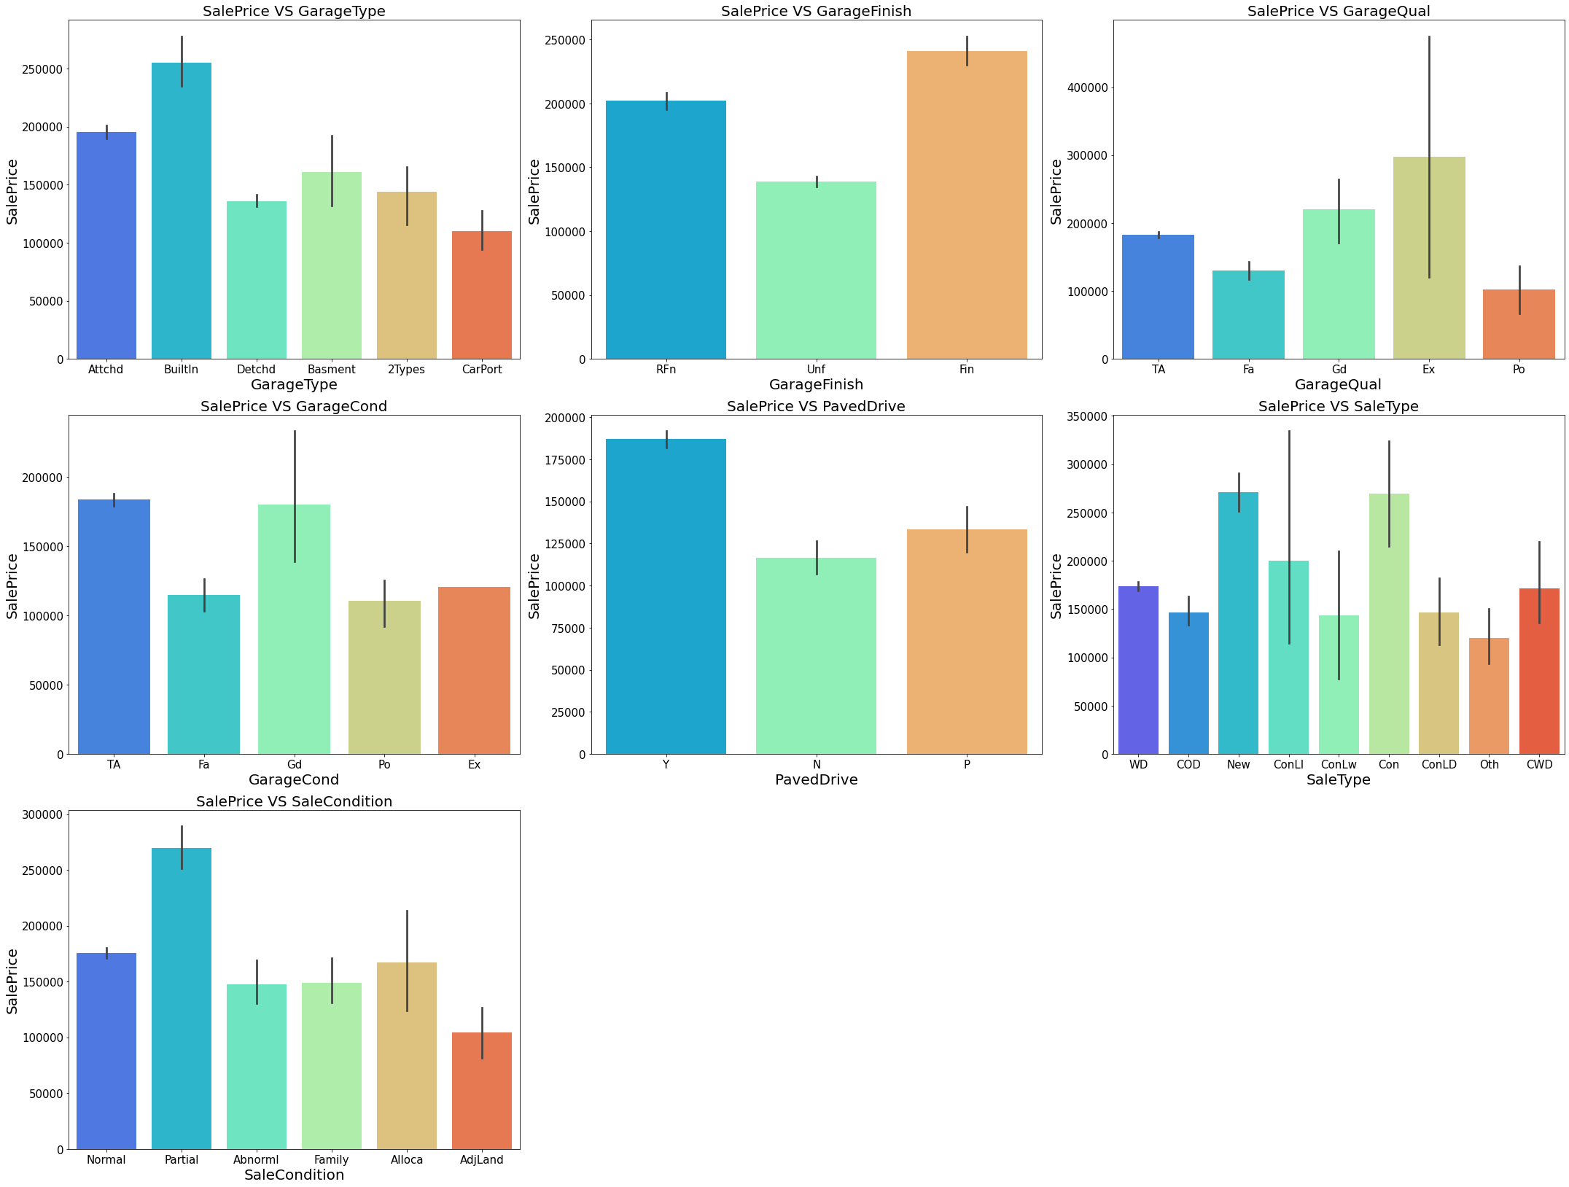
EXPLORATORY DATA ANALYSIS

Slide 28
EXPLORATORY DATA ANALYSIS
The sale price is higher for the following categories
Feature Name: Name of categories for which the sale price is higher
GarageType – Built-In (Garage part of the house – typically has room above the garage)(BuiltIn)
GarageFinish – Finished (Fin)
GarageQual - Excellent(Ex)
GarageBand - Typical/Average(TA) and Good(Gd)
PavedDrive - Paved
SaleType - Home just constructed and sold(New) and Contract 15% Down payment regular terms(Con)
SalesCondition - Home was not completed when last assessed (associated with New Homes)(Partial)

Slide 29
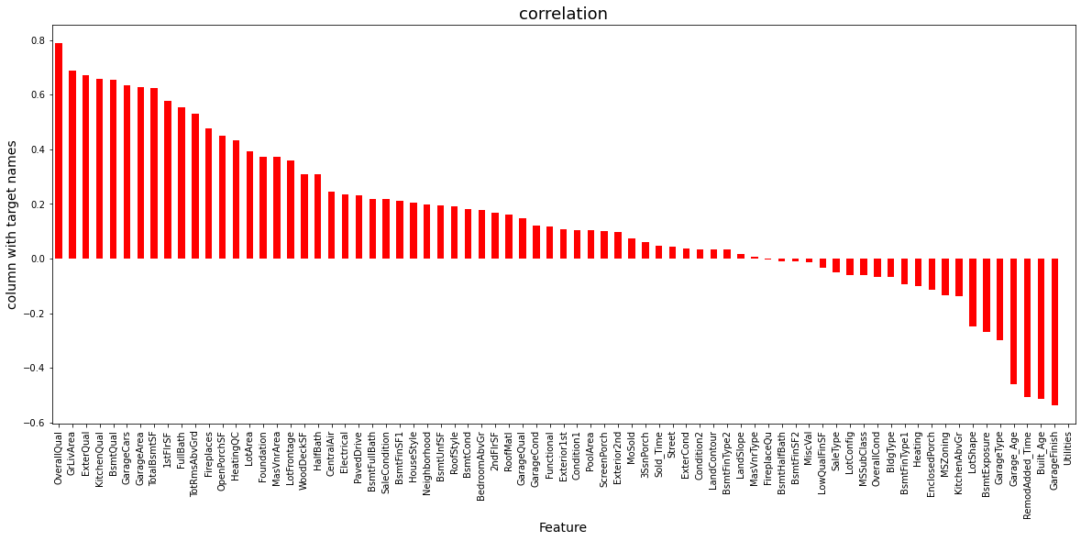
EXPLORATORY DATA ANALYSIS

Slide 30
EXPLORATORY DATA ANALYSIS
The features which are responsible for high price of house are:
OverallQual GrLiveArea ExterQual KitchenQual
BsmtQual GarageCars GarageArea TotalBsmtSF
1stFlrSF FullBatch TotRmsAbvGrd Fireplaces
OpenPorchSF HeatingQC LotArea Foundation
MasVnrArea LotFronrage WoodDeckSF HalfBath
CentralAir Electrical PavedDrive BsmtFullBath
SaleCondition BsmtFinSF1 HouseStyle Neighbourhood
BsmtUnfSF RoofStyle

Slide 31
Data Cleaning Steps
Removed Null values
In the case of categorical features, null values replaced with a mode
In the case of numerical features, null values replaced with a mean value

Slide 32
Feature Engineering
Removing Outliers
Lebel encoding of categorical features
Scaling of features
Removing unimportant features

Slide 33
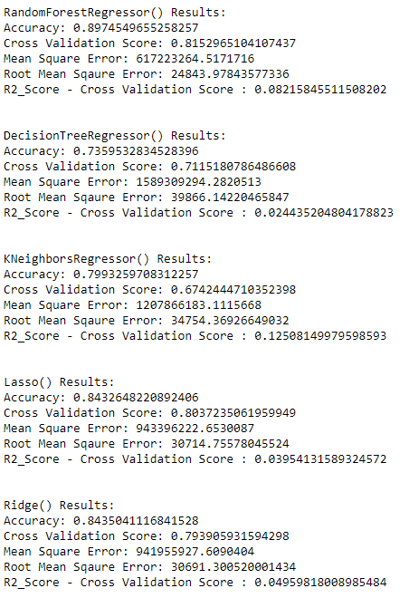
Model Building

Slide 34
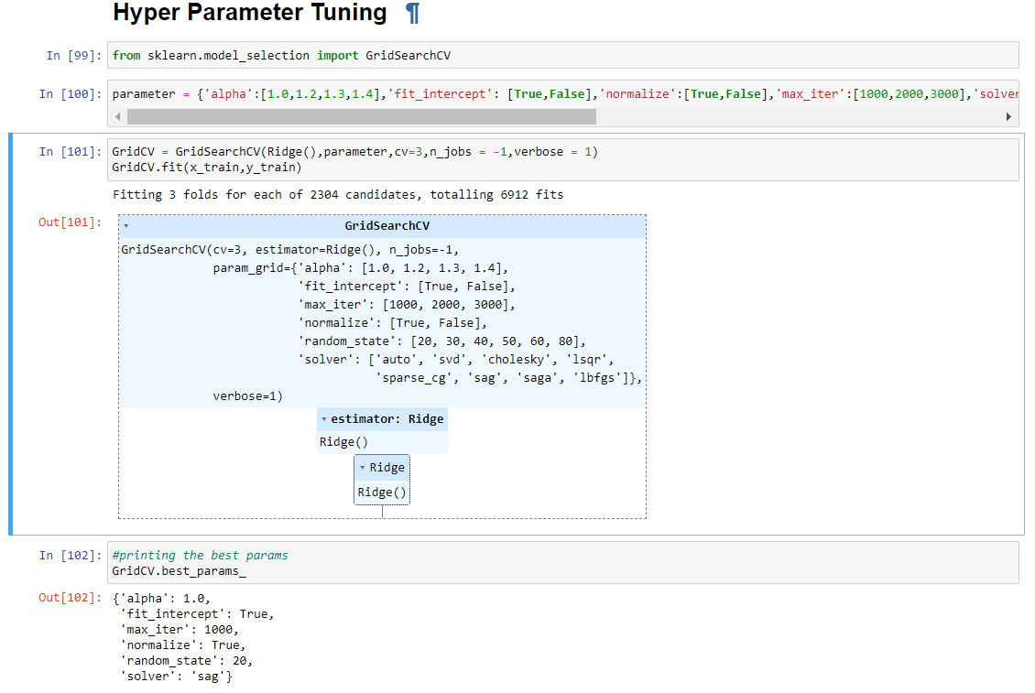
Hyper Parameter Tuning
Found the best parameter s for the final model
(ii) Build a Ridge model with 83% accuracy score.

Slide 35
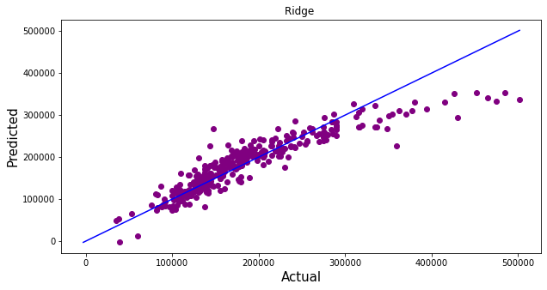
Regression Graph
Actuav Vs Predicted

Slide 36
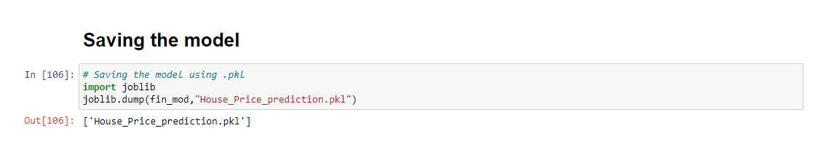
Saving the final Model
Saved the model for future use to predict used car price.

Slide 37
Conclusion
In this project report, we have used machine learning algorithms to predict the house price. We have mentioned the step-by-step procedure to analyze the dataset and find the correlation between the features.
Thus we can select the features which are correlated to each other and are independent in nature. The power of visualization has helped us in understanding the data through graphical representation it has made me understand what the data is trying to say.
Data cleaning is one of the most important steps to remove unrealistic values
We have built the Regression model also saved the best model and predicted the label.
To conclude, the application of machine learning in House price prediction is still at an early stage. We hope this study has moved a small step ahead in providing some methodological and empirical contributions to crediting institutes and presenting an alternative approach to the valuation of used cars.

Slide 38
Thank You

